Slide 1


Big Mountain Resort – ticket price prediction

Slide 2
The problem
The big Mountain resort uses a common technique to set their ticket prices for weekend as well as weekday. Based on historical decision-making, as well as market influence, the executive level adjusted the price accordingly.
Nowadays, more data-driven options exists for making business related decisions. We are using machine learning algorithms and data science to analyze, train and apply our predictive models and come with accurate predictions or solutions to be implemented by decision-makers.
The current ticket price is set for $81 for any day of the week.
Our criteria for success is providing a data-driven business strategy for the next year that will increase profitability.

Slide 3
The problem
The key data used was a database of all resorts with their attributes, as well as some business scenarios provided by the Director of Operations.
While we were able to come to powerful insights using the available data, we remind the fact that no data is useless, in this direction recommending the collection of some future data containing daily traffic in the resort and operating cost per each facility in the resort.
The scope of our research was either finding how you can increase the ticket price or by maintaining the same price while reducing some operating costs.
Additionally, 4 scenarios were taken into consideration into our modeling:
1) Permanently closing down up to 10 of the least used runs.
2) Increase the vertical drop by adding a run to a point 150 feet lower down but requiring the installation of an additional chair lift to bring skiers back up, without additional snow making coverage
3) The same scenario as 2, but adding 2 acres of snow making cover
4) Increasing the longest run by .2 miles and guaranteeing its snow coverage by adding 4 acres of snow making capability.

Slide 4
Recommendations and key findings
Our machine learning model used data from all ski resorts in US and returned a ticket price value of $95.87, with an expected mean absolute error of $10.39, concluding there is room for an increase.
This modeling must be looked at optimistically and doubtfully, as there might be some other factors to play a role in price determination what we did not used in our modeling.
We also took into analysis four potential business scenarios.
The resulted business plan for this upcoming year consists of 2 major steps followed by 3 month of assessment and another final step.

Slide 5
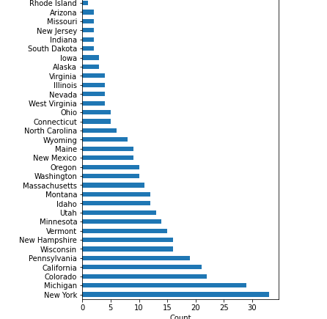
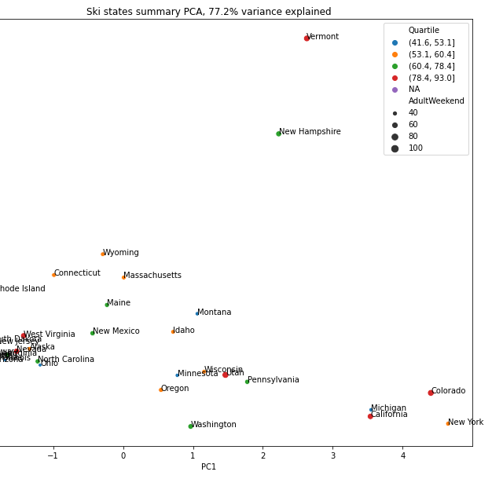
Initial data analysis
We started our analysis from a dataset of all ski resort from US.
After our exploratory data analysis, we observed no clustering on features on resort from different state, so we continued our analysis on the records we had from all states.

Slide 6
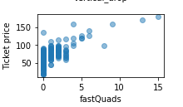
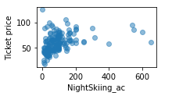
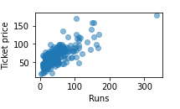
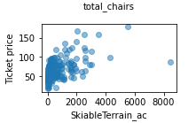
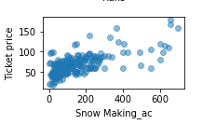
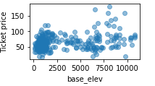
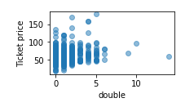
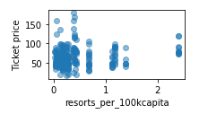
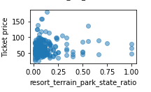
Ticket price variation with other features
As expected, some features will impact strongly the ticket price, while other might not have such a big impact.
Out of those with a positive correlation, the highest correlated were:
Total runs
Number of fast quads
Night Skiing area
Snow making area
Total chairs

Slide 7
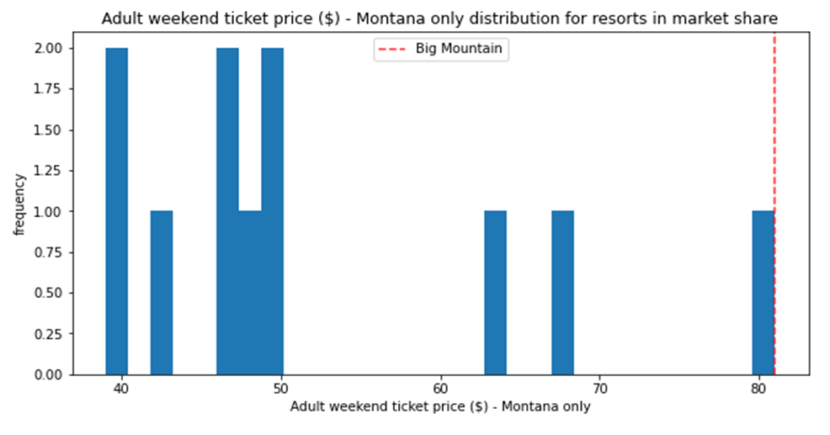
Modeling data and scenarios
Our machine learning model returned a ticket price value of $95.87, with an expected mean absolute error of $10.39.
This means that we can increase the ticket price to at least $85.48 and at most $106.26, considering the given facilities.
Nevertheless, we must consider the fact that our prices are the highest in the state, and that increasing the price too much might drive away customers, therefore the steps we will recommend will not contain such a big price increase.

Slide 8
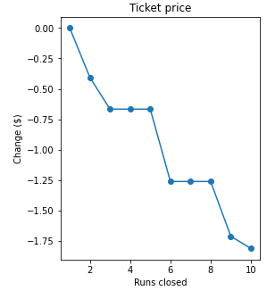
Conclusions
Based on this and on the scenarios presented, we recommend the following two steps to be implemented as soon as possible:
Increasing the ticket price by $1.99 to cover the newly installed chair expenses.
The removal of 1 run, action that our model predicts is not having an impact of the ticket price.
After the implementation of these 2 steps conduct a general survey to determine customers satisfaction, and if the changes are rather unimpactful, after 3 months you can implement one of the 2 steps:
If the cost of maintaining runs is substantial, remove 4 more runs, with lowering the ticket price by $0.67.
Apply scenario 2, with an additional increase on $1.99 in ticket price.
Finally, continue to gather data, adding information about daily traffic as well as operating costs for each feature, so in near future we can make even more powerful data analytics.

